Slide 1
Components of An Industrial Robot- Part 2
IMSE 381:INDUSTRIAL ROBOTS
Lecture 3
IMSE381
Notes:
IMSE 381
E. ORADY

Slide 2
Basic Components of Robots
Manipulator or Arm
Actuators
Control Unit
Sensors
IMSE381
Notes:
IMSE 381
E. ORADY

Slide 3
Control Unit
It is the brain of the robot.
It usually performs three functions:
  Initiate and terminate the motion of individual components of the manipulator
  Store data for points and sequence of operations
  Facilitate interface with other units in robot workcell
IMSE381
Notes:
IMSE 381
E. ORADY

Slide 4
Control Unit Capabilities
To perform these functions, the controller should be capable to:
  Perform necessary arithmetic computation for determining manipulator path, speed and position
  Send signals to the joint-actuating devices and utilize sensors information
  Permit communication between peripheral devices and manipulators
IMSE381
Notes:
IMSE 381
E. ORADY

Slide 5
Type of Control Systems
Open-loop (Non-Servo) Control Systems
Closed-loop (Servo) Control Systems
IMSE381
Notes:
IMSE 381
E. ORADY

Slide 6
Open-Loop Control
Input
Output
Controller or
Drive
* Simple
* No feedback
* Can be applied only on situations
in which no change in output
occurs i.e. zero disturbance
Disturbance
IMSE381
Notes:
IMSE 381
E. ORADY

Slide 7
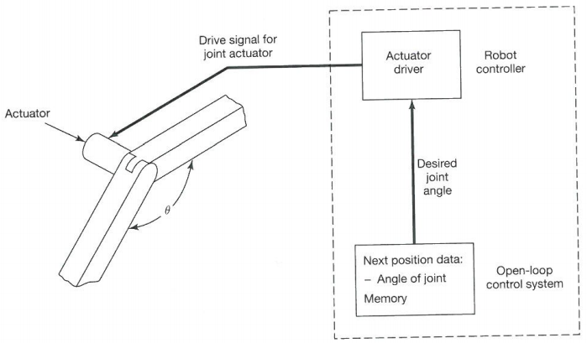

Open-Loop Control
IMSE381
Source: Rehg
Notes:
IMSE 381
E. ORADY

Slide 8
Non-servo-controlled robots
Simplest
Referred to as limited-sequence robots, or end point robots, or pick and place, or bang-bang robots
Axes are controlled by limit switches, therefore, the axes stay on motion until the limits of the travel.
Hence, each axes has two positions only
Programmed by setting a desired motion and adjusting the position of the end stops
Power provided by electrical motors, or pneumatic or hydraulic motors.
IMSE381
Notes:
IMSE 381
E. ORADY

Slide 9
Non-servo-controlled robots (continue)
It is referred to as “open-loop”control
It is possible, in some robots, to have intermediate stops and allow path control
Robots are relatively small and have high speeds
They are low cost, easy to operate and reliable
They have a high repeatability about +/- 0.01 inch.
They have limited flexibility with respect to positioning and programming.
IMSE381
Notes:
IMSE 381
E. ORADY

Slide 10
Internal Positioning Devices for Open-Loop Control
Fixed Hard Stops
  Limit the movement of pneumatic or hydraulic actuators at each end of their travel
Adjustable Hard Stops
Limit Switches
Stepper Motors
IMSE381

Slide 11
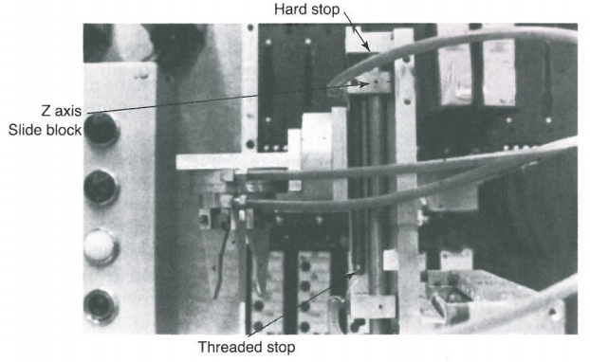
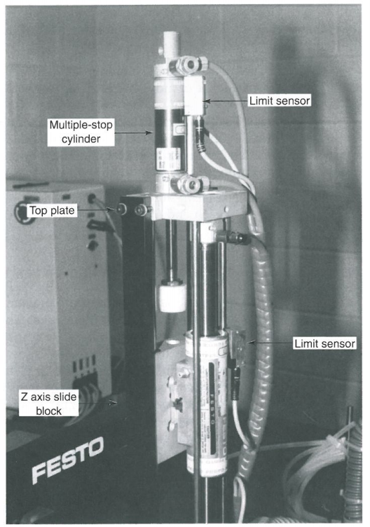
Internal Positioning Devices for Open-Loop Control
Source: Rehg
Adjustable Hard Stops on B-A-S-E Robot
Limit Sensing and Multiple Stops on Festo Robot
IMSE381
Notes:
IMSE 381
E. ORADY

Slide 12
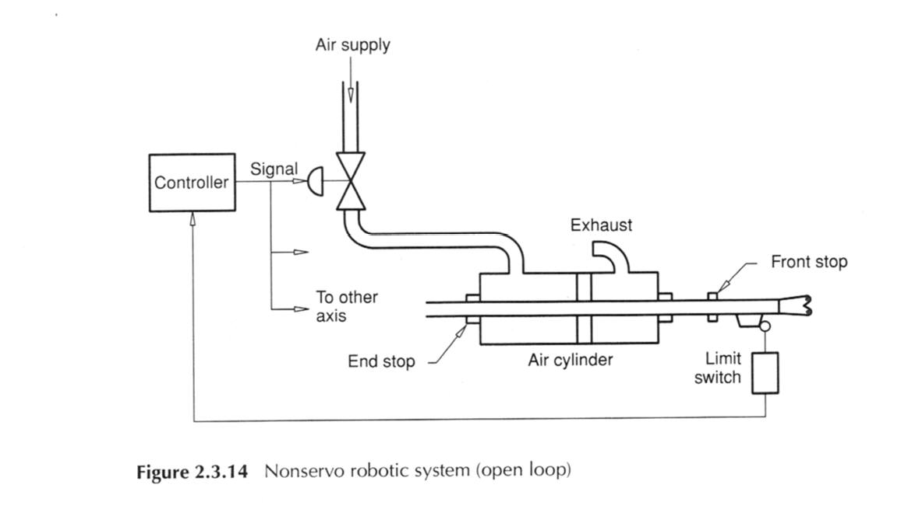
Example of Nonservo System
IMSE381
Notes:
IMSE 381
E. ORADY

Slide 13
Closed-Loop Control Systems
Uses error detector that returns a signal proportional to the difference between input and feedback
Input +
Output
Error
detector
Drive
Component
_
Closed-loop
Feedback
Signal
Sensing Device
IMSE381
Notes:
IMSE 381
E. ORADY

Slide 14
Closed-Loop Control
Characteristics
  More accurate and repeatable than open-loop
  Feed back may cause instability such as vibrations
  More complex and need more maintenance than open-loop
Closed-loop systems use servomechanisms
  A typical servomechanism require the following elements
    Transducer: to sense an output condition and transform it to sensible understandable signal to the servo-system
    Servomotor: drive and respond to output gain
    Amplifier: to boost the magnification of input and feedback.
IMSE381
Notes:
IMSE 381
E. ORADY

Slide 15
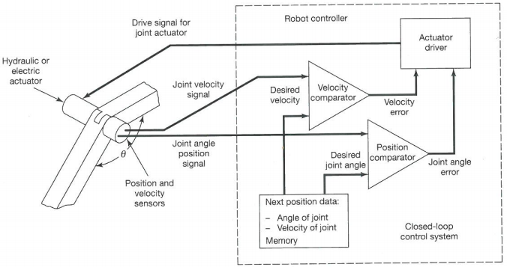
Closed-Loop Control Systems
Source: Rehg
IMSE381
Notes:
IMSE 381
E. ORADY

Slide 16
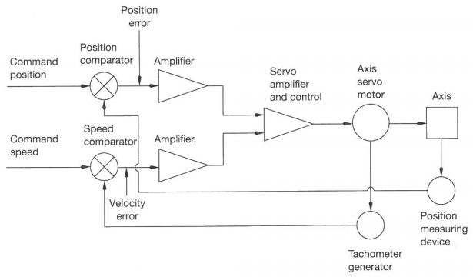
Closed-Loop Control Systems
Source: Rehg
Notes:
IMSE 381
E. ORADY

Slide 17
Path Control for Robots
There are three basic classes:
  Non-servo-controlled robots
    Stop-to-stop
  Servo-controlled robots
    Point-to-point
    Continuous path
IMSE381
Notes:
IMSE 381
E. ORADY

Slide 18
Typical Program for Non-servo-controlled Robots
Move robot to start position
Grasp part
Remove the part from a machine
Move to second position
Insert the part on another machine
Prepare to start another cycle
IMSE381
Notes:
IMSE 381
E. ORADY

Slide 19
Typical Operation of Non-servo-controlled Robots
Program starts causing the controller (sequencer) to signal control valves on the manipulator’s actuators
This leads to opening appropriate valves to let air or oil flow to the actuators to move the desired axes
The valves remain open and the axes continue moving until they reach the end-stop; usually sensed by limit switches
Limit switches are then send signals to the controller to command the open valves to close
The controller then switches to next step and the controller again output signals to actuator valves, thereby causing other members of the manipulator to move or signals could be send to external devices such as a gripper open and close.
The process is repeated until all steps in the program is executed.
IMSE381
Notes:
IMSE 381
E. ORADY

Slide 20
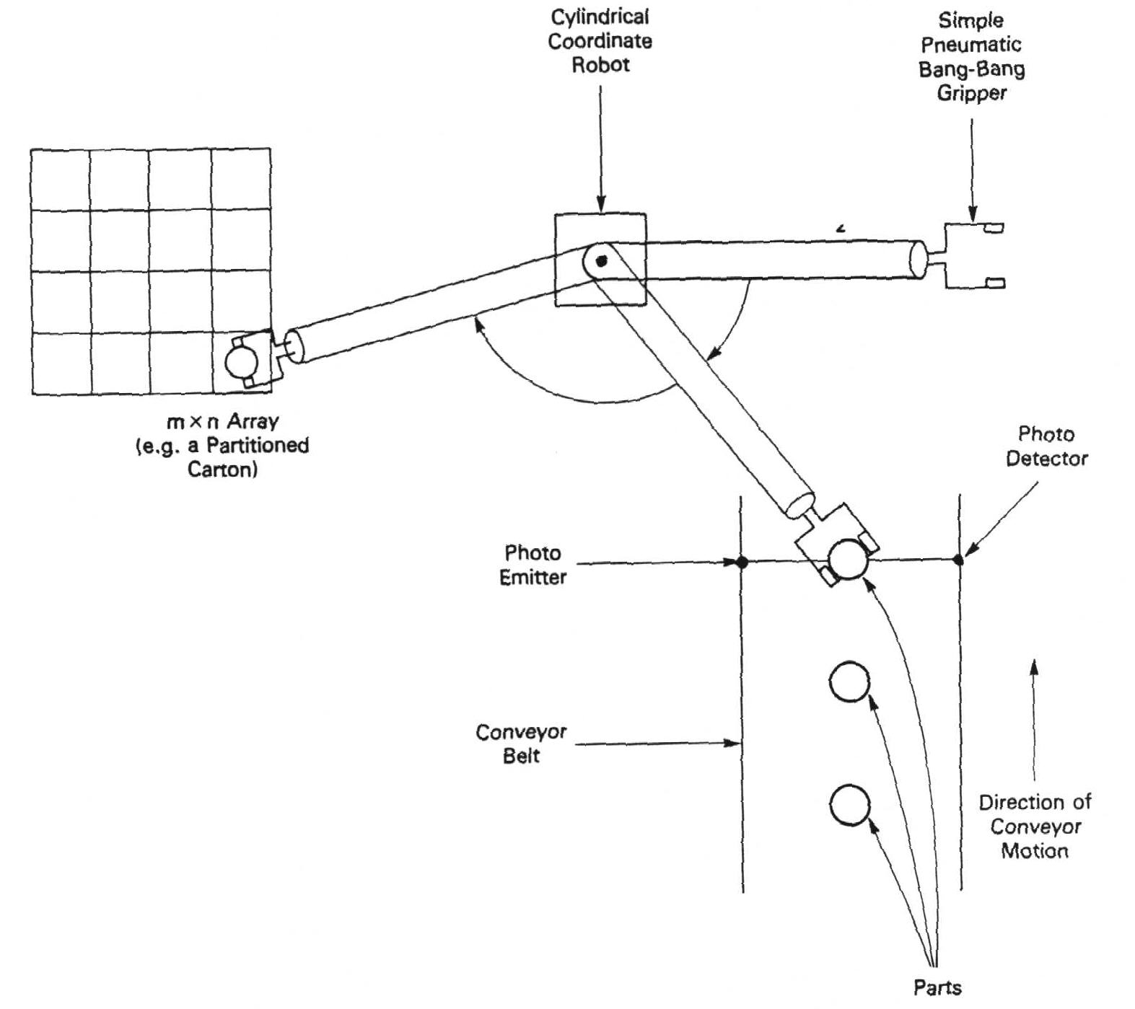
Point-to-Point Servo Controlled Robots
Used in moving parts, and handling tools
Palletizing and de-palletizing
Only initial and final points need to be programmed
High work volume and load carrying capacity
Common use in operation such as spot welding
Source: Klafter, Chmielewski, and Negin
Palletizing and de-palletizing
IMSE381
Notes:
IMSE 381
E. ORADY
When a part moving on a conveyor interrupts the light beam from a photo emitter, the controller commands the robot to acquire the part. This part is then moved to and placed in one of the empty locations in a partitioned carton. This process is repeated until all such locations are filled, at which time the carton is removed from the loading station, an empty one replaces it, and the operation is repeated.

Slide 21
Point-to-Point Programming
Using the teach pendant, the operator moves the tooling or gripper into position
Command the controller to record in memory the current coordinate values
The same procedures are repeated at the next desired points
Has a capability to ‘branch’ to different positions (see previous example)
Note the path that the robot takes as the programmer moves the tool from one position to another will have no effect on the final program path when the program runs (see Fig. 2-50)
The actual path will be determined such that each joint axis moves at its fasted speed that is possible (see Fig. 2-51)
IMSE381

Slide 22
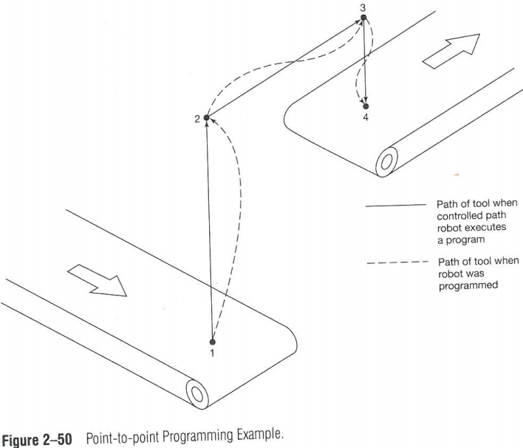
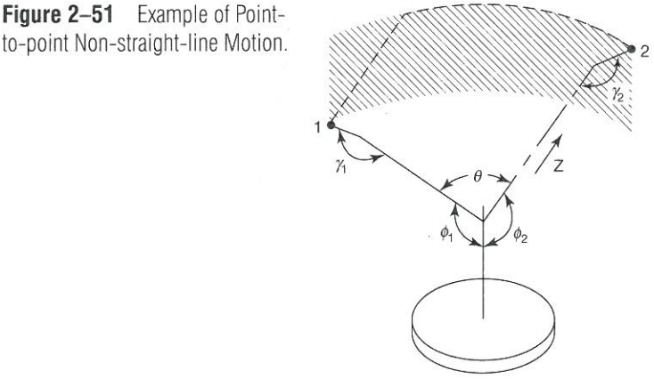
Point-to-Point Control
Source: Rehg
IMSE381

Slide 23
Continuous-path servo-controlled robots
Can perform complex paths and high speeds
Used in spray painting, arc welding, polishing, grinding, etc.
The path can be taught using special device to sample points at a proper rate through the path
Several path types such as linear and circular paths can be directly programmed without sampling
The robot can be programmed off-line using robot simulation packages such as ROBOGUIDE
IMSE381
Notes:
IMSE 381
E. ORADY

Slide 24
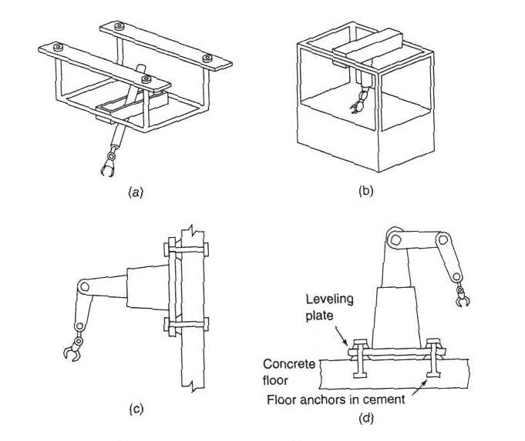
Robot Mobility
Source: J. l. Fuller
Robots can be classified by base mount as:
  Stationary robots
  Mobile robots
Stationary Robots
  Fixed-position bases
    Floor mounted
    Overhead mounted
      Ceiling
      Gantry
    Wall-mounted
Ceiling -mounted
Over-head Gantry
Wall-mounted
Floor-mounted
IMSE381
Notes:
IMSE 381
E. ORADY
Figure (a) is a ceiling mounted robot. This is generally not a practical arrangement.
Figure (b) is an overhead gantry mount, the most common way to mount a robot from above.
Figure (c) is a wall mounted robot. This arrangement saves floor space, but unless the wall is very rigid, the robot will lose some accuracy
Figure (d) is a floor mounted robot. This setup requires a very stable floor.

Slide 25
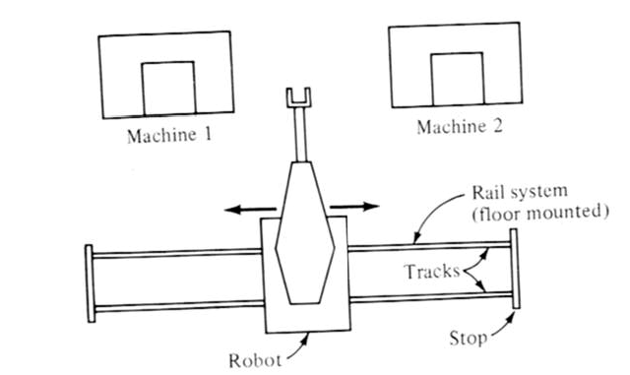
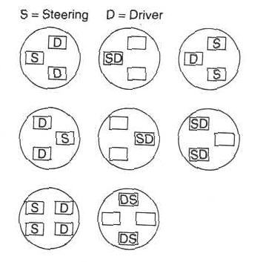
Mobile Robots
Source: Groover
Source: J. l. Fuller
Track mounted robot
Free moving wheels
Multiple leg-devices
Configurations for wheeled vehicle
IMSE381
Notes:
IMSE 381
E. ORADY

Slide 26
Load Carrying Capacity
Robot’s load carrying capacity is the net weight that a robot can manipulate on its work volume.
Net Load C. C.= Gross weight - weight of end effector
Load C.C. should be specified when the robot arm is in the weakest position; for example, when the arm is fully extended in case of Polar, cylindrical, or Jointed-arm configurations
IMSE381
Notes:
IMSE 381
E. ORADY

Slide 27
Precision of Robot’s Movements
Precision is defined as function of:
  Spatial resolution
  Accuracy
  Repeatability
Terms are defined at:
  Wrist end without tool attached to it
  Worst condition
  Point-to-point control
IMSE381
Notes:
IMSE 381
E. ORADY

Slide 28
Spatial Resolution
It is defined as the smallest increment into which the robot can define its work volume.
It is function of:
  System Control Resolution
  Robot Mechanical Inaccuracies
IMSE381
Notes:
IMSE 381
E. ORADY

Slide 29
Control Resolution
It is defined as the ability of the controller to divide the total range of movement for a particular joint into individual elements that can be addressed by the controller. The increments are called “addressable points.”
It is determined by
  Robot positioning control system
  Feedback measurement system
IMSE381
Notes:
IMSE 381
E. ORADY

Slide 30
Control Resolution
Ability to divide the range is function of the bit size (n) of the controller.
Range
Addressable point
No. of addressable points = 2^{n}
Controller Resolution = Range/ 2^{n}
IMSE381
Notes:
IMSE 381
E. ORADY

Slide 31
Control Resolution for Several Axes
The control for several axes (d.o.f) is the vectorial sum of a all components.
Since there is a combination between rotational and translational motion, it could be very complicated to determine the overall control resolution
For a three-axis Cartesian robot
CR_{t} = (CR_{x}² +CR_{y}² + CR_{z}²)^{1/2}
IMSE381
Notes:
IMSE 381
E. ORADY

Slide 32
Mechanical Inaccuracies
Mechanical inaccuracies of robot joints are caused by:
  Elastic deformation
  Gear backlash
  Stretch of pulley cords
  Leakage in hydraulic system,
  other imperfections
Mechanical inaccuracies = 6 σ
Where σ is the standard deviation of motion distribution
IMSE381
Notes:
IMSE 381
E. ORADY

Slide 33
Spatial Resolution
Thus spatial resolution (SR) is the sum of the control resolution (CR) and the mechanical inaccuracies.
SR = CR + 6 σ
CR
3 σ
3 σ
3 σ
3 σ
SR= CR + 6 σ
IMSE381
Notes:
IMSE 381
E. ORADY

Slide 34
Accuracy
Accuracy refers to the robot ability to position its wrist end at a desired target point within its work volume. It can be defined in terms of spatial resolution as:
Accuracy = 0.5 SR = 0.5 (CR + 6 σ)
Accuracy
Target
SR
Addressable
point
Addressable point
IMSE381
Notes:
IMSE 381
E. ORADY

Slide 35
Factors Affecting Robot Accuracy
Factors affecting robot accuracy
  Location within work volume
  Motion cycle
  Load
IMSE381
Notes:
IMSE 381
E. ORADY

Slide 36
Repeatability
Repeatability refers to the robot ability to return to the programmed point when commanded to do so. It concerns with the ability of the robot to position its wrist or end effector attached to its wrist at a point in space that had previously been taught to the robot.
Repeatability = ± 3 σ
Addressable point
Target
One axis
R
- r
+ r
Accuracy error
IMSE381
Notes:
IMSE 381
E. ORADY

Slide 37
Example
One of the axes of an RRL robot is a sliding mechanism with a total of 0.70 m (about 27.5 in.). The robots control memory has a 10-bit capacity. In addition, it has been observed that the mechanical inaccuracies associated with moving the arm to any given programmed point form a normally distributed random variable with the mean at the taught point and the standard deviation equal to 0.10 mm (about 0.004 in.). Assume that the standard deviation is isotropic (it is equal in all directions). By definition, three standard deviations include “all” of the mechanical errors in the arm movement. With these definitions and assumptions, determine the following:
(a) The control resolution of the axis
Control resolution (CR) = Range / 2^{n} = (0.7 * 1000)/2¹⁰ = 0.684 mm
(b) The spatial resolution of the axis
Spatial resolution (SR) = CR + 6 σ = 0.684 +6*0.10 = 1.284 mm
(c) The defined accuracy of the robot for this axis
Accuracy = 0.5 SR = 1.284/2 = 0.642 mm
(d) The repeatability of the axis
Repeatability = ± 3 σ = ± 3 * 0.10 = ± 0.30 mm
IMSE381
Notes:
IMSE 381
E. ORADY

